Slide 1
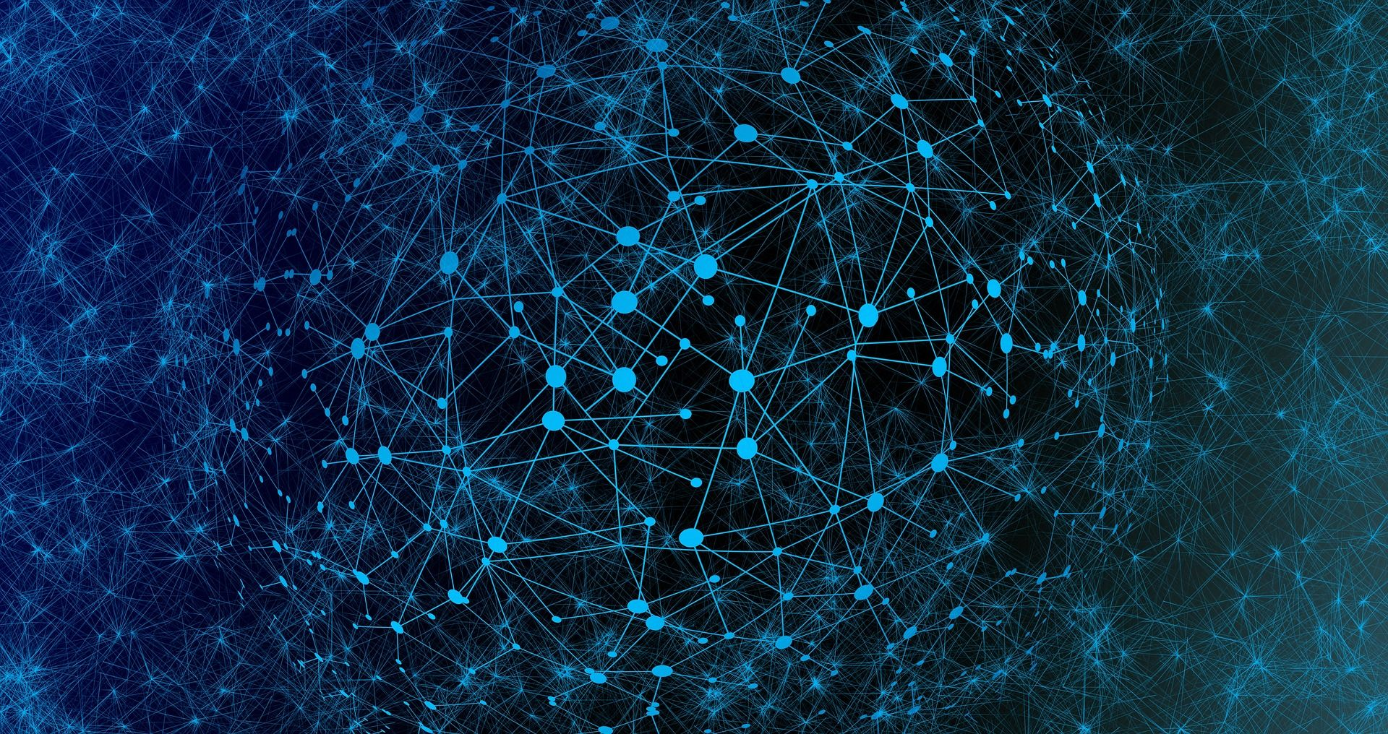

Gated Graph Sequence Neural Networks
Junhee Cho
Network Science Lab
The Catholic University of Korea
E-mail : junhe0733@gmail.com

Slide 2
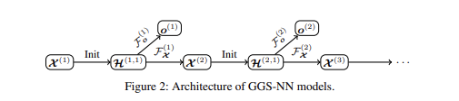
Architecture

Slide 3
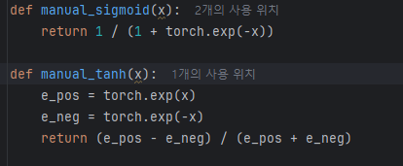

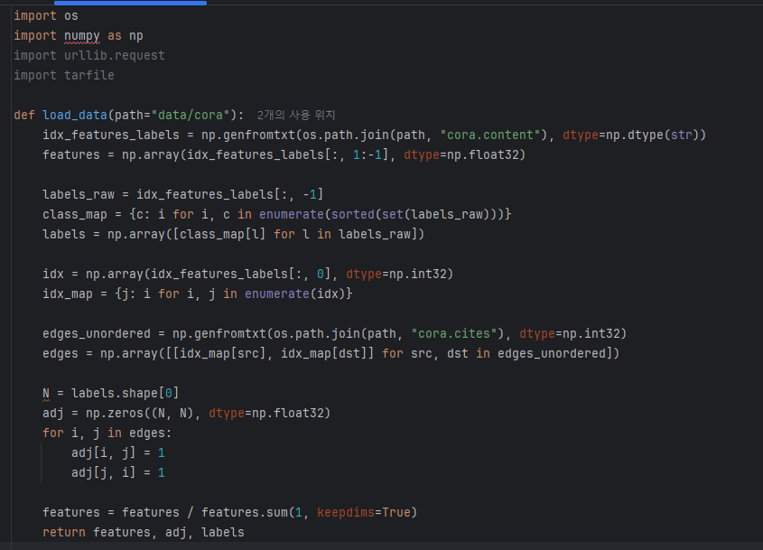

Code
Activation function

Slide 4
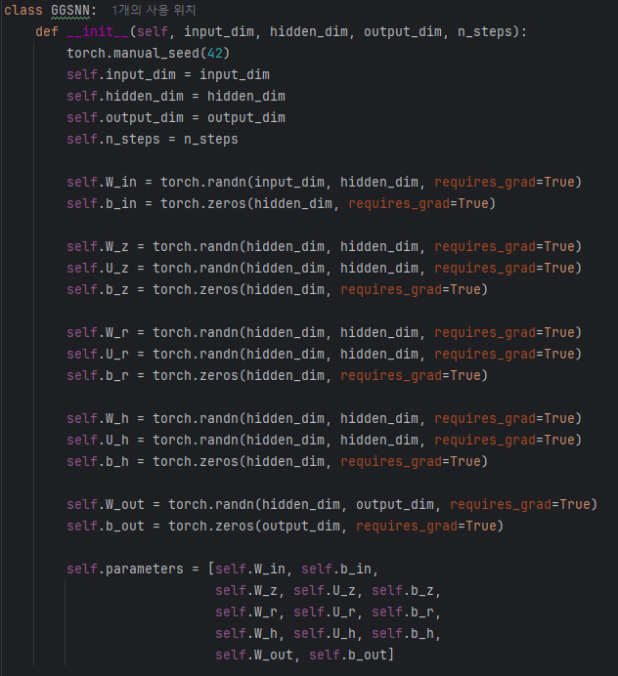
Code
Init

Slide 5


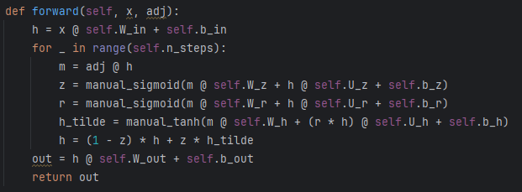
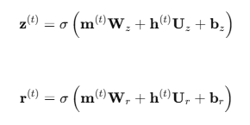



Code
Forward

Slide 6
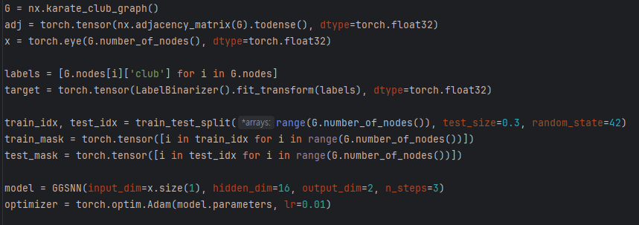
Experiment
1

Slide 7
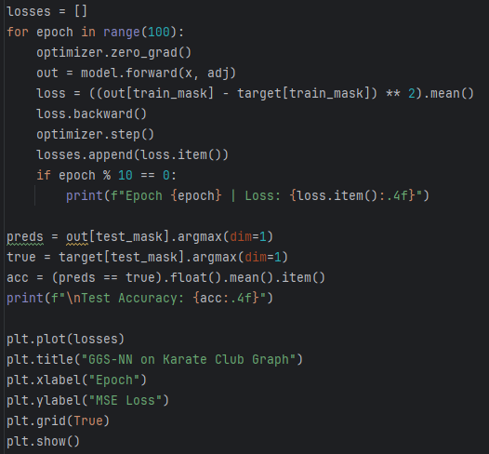
Experiment
2.

Slide 8
Experiment
2.

Slide 9
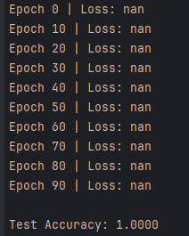
Experiment
Acc

